Slide 1



Heading
Right Care, Right Person
Police questions
Public

Slide 2
Questions?
Is their location known?
Have reasonable enquires been made to establish their whereabouts?
Is there a real and immediate risk to life/serious harm to an individual or the wider public?
What is your relationship to the person?
Does the Concern relate to a child?

Slide 3
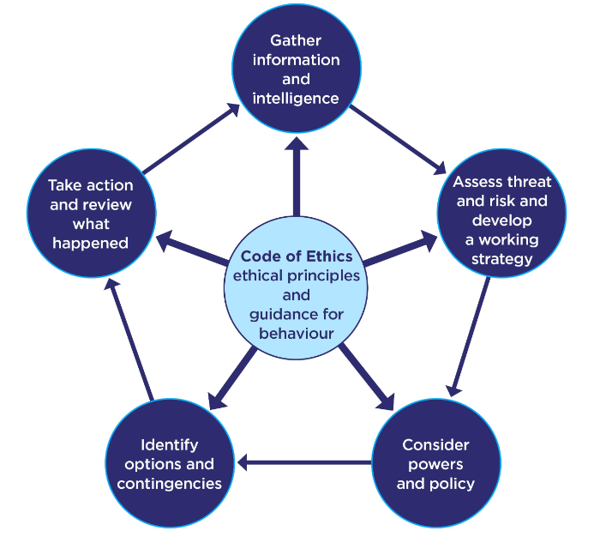
Risk Assessment
T - Threat
H - Harm
R - Risk
I - Investigation
V - Vulnerability
E - Engagement

Slide 4
Yes
Maybe
No
At this time, I am not sure if the incident meets the threshold for Police attendance and as a result, I will be asking a supervisor to undertake a further risk review of this incident. We will be conducting further checks. While we are making these checks we will not be attending this incident and have not accepted responsibility. We will make further contact with you (obtain a contact number) once the review has been completed.
This incident does not meet the threshold for attendance by Police and as a result the police will not be attending or taking any action in relation to this incident at this time.
This incident does meet the threshold and as a result the police will attend and assist in this matter.
If the situation changes or escalates, please recontact.

Slide 5
Advice
Concern | Signposting
Physical Health | Pharmacy/111/GP/Ambulance
Mental Health | MH Charities/111-2/Crisis Team
Adult Welfare Concerns | Local authority – Adult social care
Child Welfare Concerns | Local Authority – Childrens services
Housing/Homelessness | Local authority housing department
Substance Misuse | Various services
Notes:
Harm reduction team.

