Slide 1
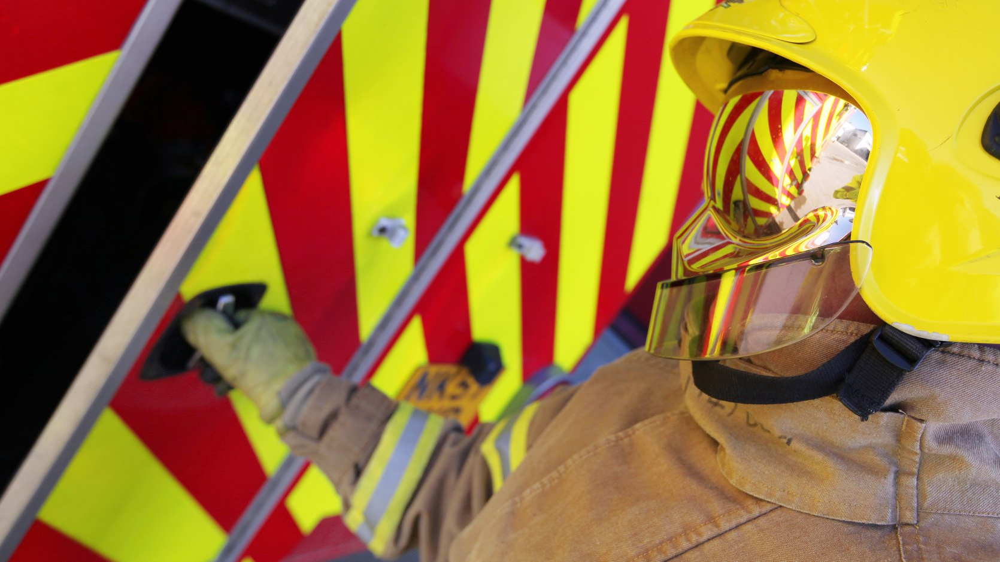

Self Neglect and Fire Safety
Sarah Litt

Slide 2
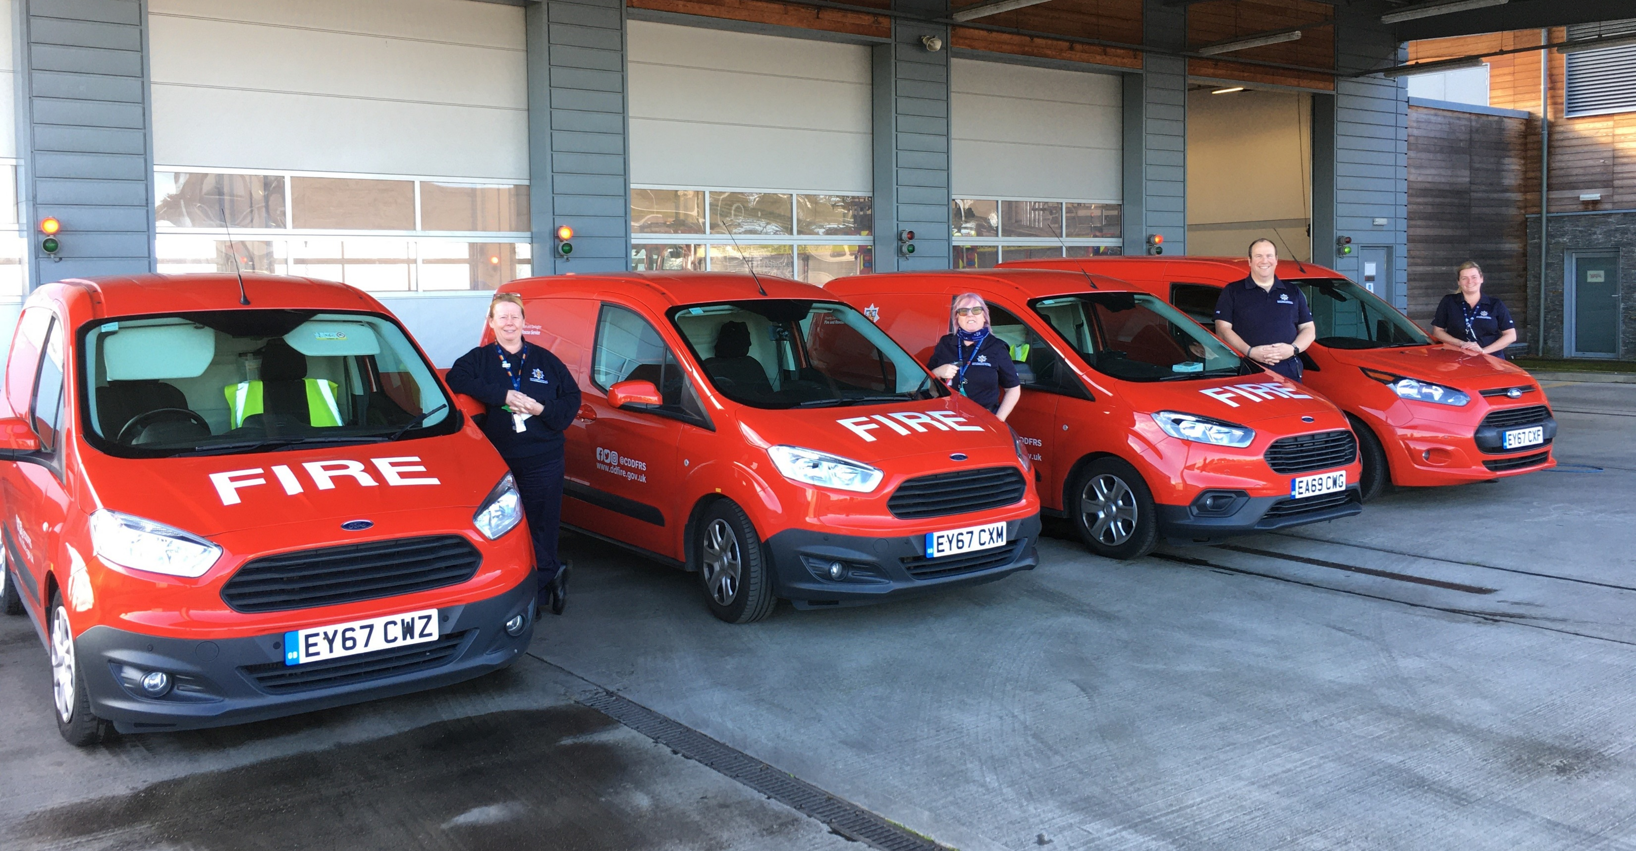

Why are we here?
Explore how self neglect and fire safety are linked
Look at themes of recent serious fires
Explain how we can help you work with your service users to improve safety
Promote our ‘Eyes Wide Open’ training offer

Slide 3
Risk and Consequence
For some people in the community, the consequence of them having a fire could be very serious
These are generally the most vulnerable
Often showing signs of self neglect

Slide 4
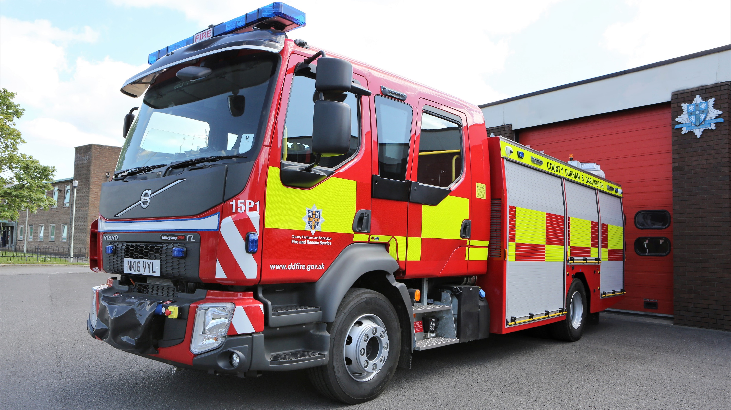
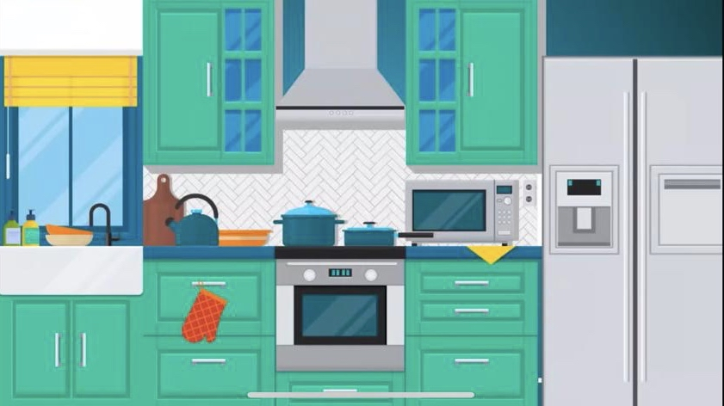
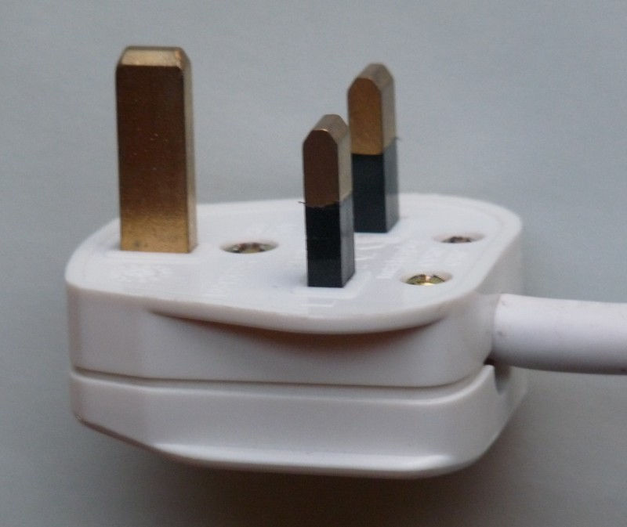
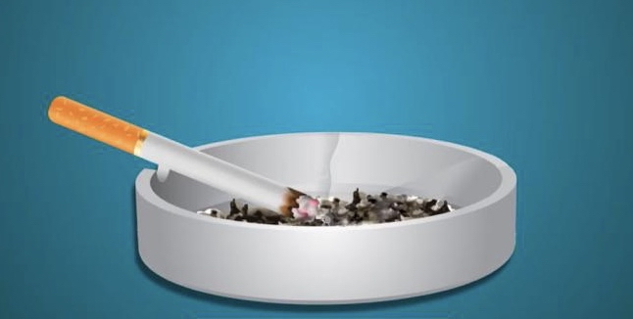
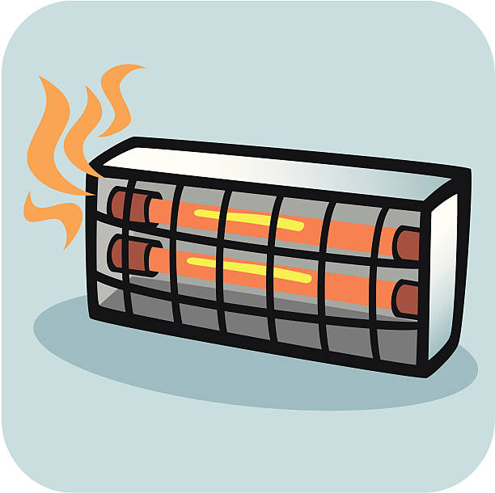
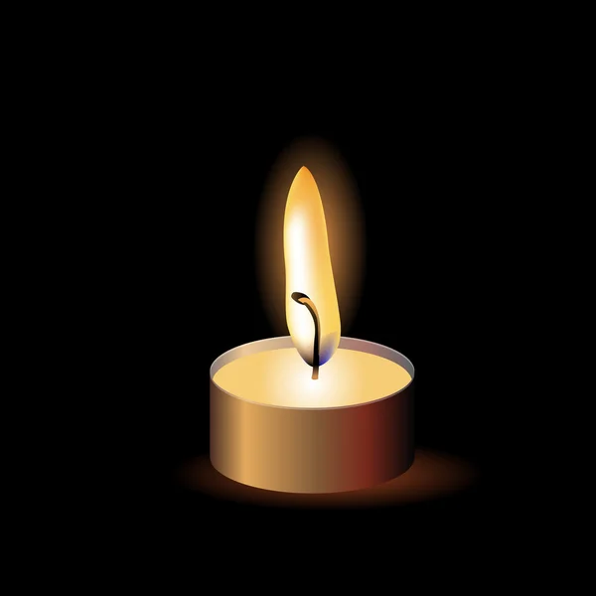
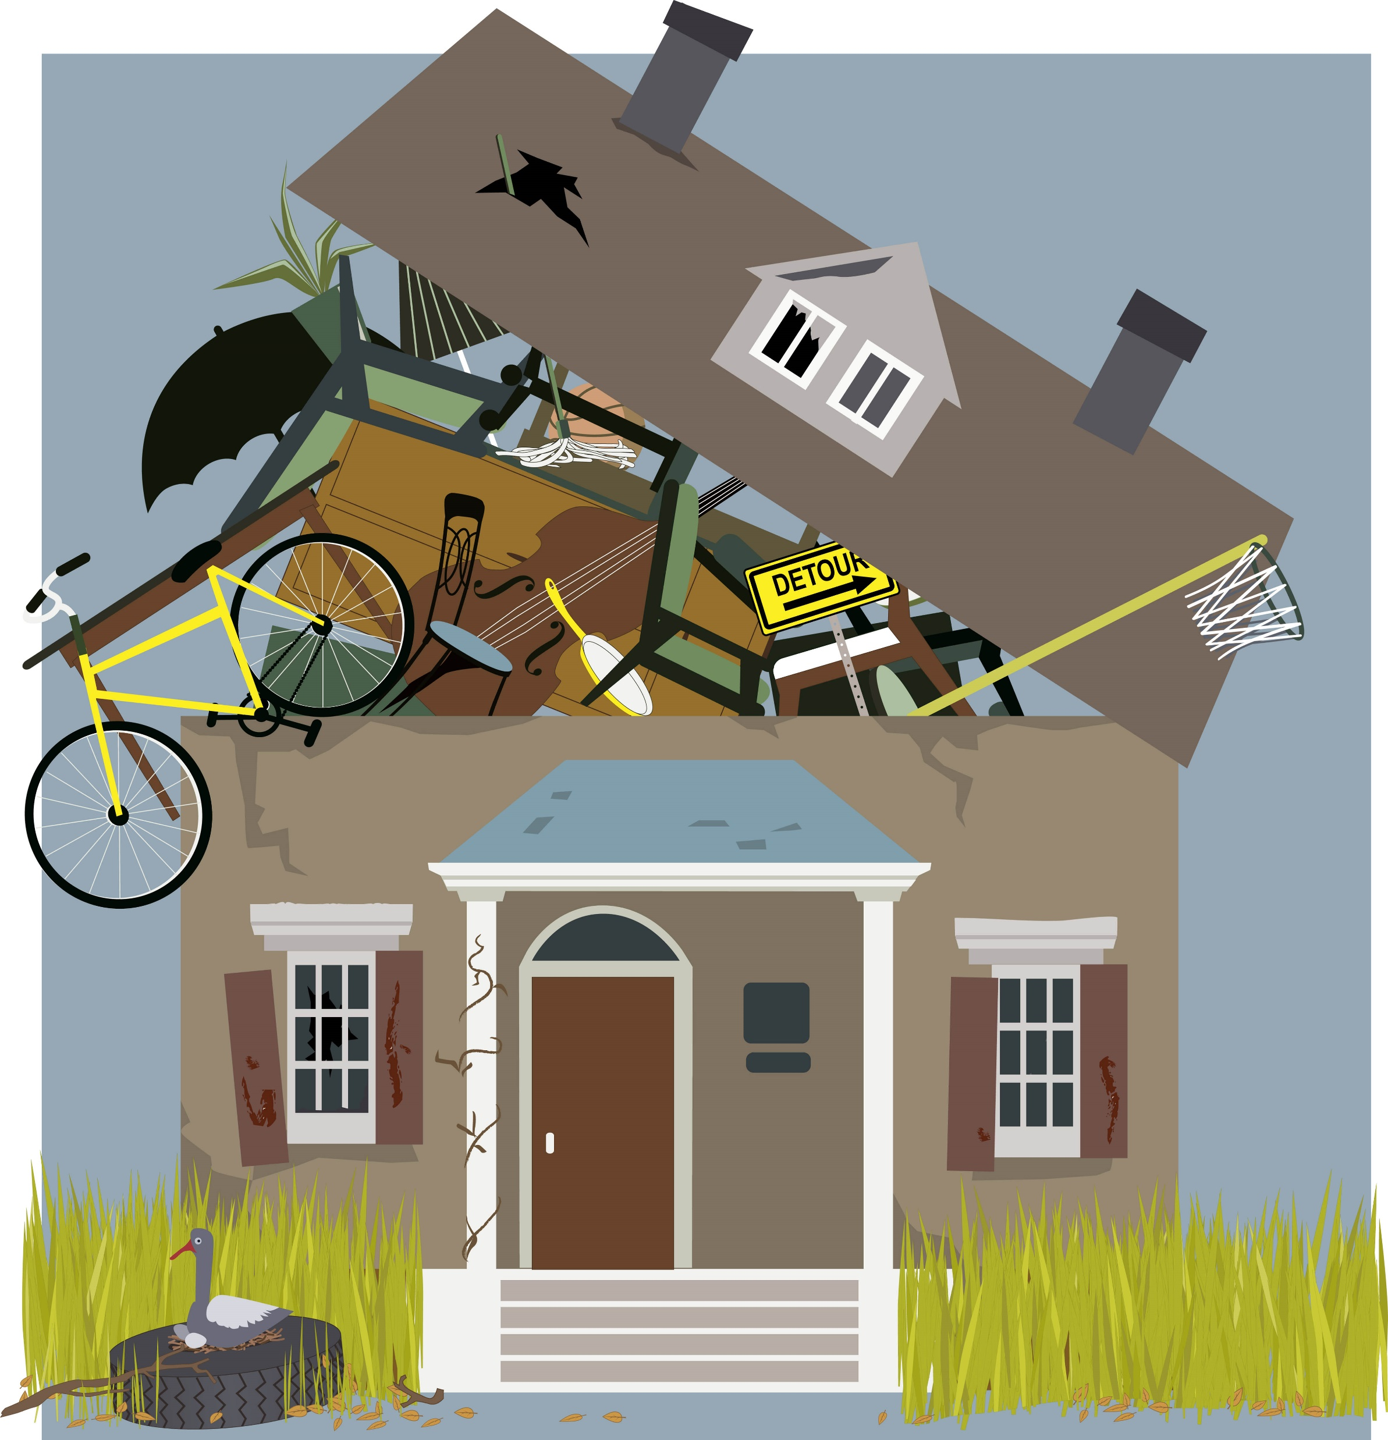
Fire Risks

Slide 5
Increased consequences of fire?
Person
Frailty
Poor Physical Health
Poor Mobility
Unable to self-evacuate
Poor Mental Health
Dementia
Older Person
Cognitive Impairment
Sensory Impairment
Lifestyle
Poor cooking practices
Careless smoking practices
Alcohol misuse
Drug misuse
Hoarding
Self-neglect
Lack of engagement with Services
Environment
Living alone
Smoke alarm not present
Smoke alarm not working
Use of heating types that present an ignition source
Hoarding
Oxygen use
Inability to raise an alarm
Evidence of previous fires
Living alone

Slide 6

Working Together
Working in partnership we can keep more people safe
Complete joint visits where possible
Access to properties we may not otherwise gain entry into
Information sharing
Referrals to our partner agencies
Continued support after our visit
Notes:
We work in partnership with organisations to keep our communities safe. Our partner agencies work with many more members of the community than we become aware of, so the eyes of partners are really important to us.
Whilst we are lucky the Fire Service has a good reputation, we are always looking to get into the homes of the most vulnerable people we do not know about. We have tools and metrics we use to target our visits, but we welcome partner referrals. As fellow professionals, if you gain access to members of the community who are vulnerable and feel a visit from us would be beneficial, we want to know that information.
Equally, we have referral pathways from our visits to support occupants with falls, smoking cessation, alcohol reduction, warmer homes schemes, the Alzheimer's Society and loneliness and isolation.
Wherever possible, we like to complete joint visits. There are several benefits to this.
It gets us over the threshold. Often the people we deal with are suspicious of professionals, and if you already have a level of trust with the person, and we attend with you we get their implied trust and allowed access to the property.
A joint visit can allow our messages to be repeated once we have left.
Staff safety.

Slide 7

How can we help?
Home Fire Safety Visit – what does this involve?
External referral pathways
Smoke alarm check/installation
Provision of additional equipment
Safeguarding

Slide 8

Eyes Wide Open Training
Free group training from CDDFRS
Around 45 - 60 minutes
Microsoft Teams or in person
Identify how signs of increased risk of fire
How to refer for a visit
Information card
Partner/Professional Referrals and Training | County Durham and Darlington Fire and Rescue Service (ddfire.gov.uk)

Slide 9
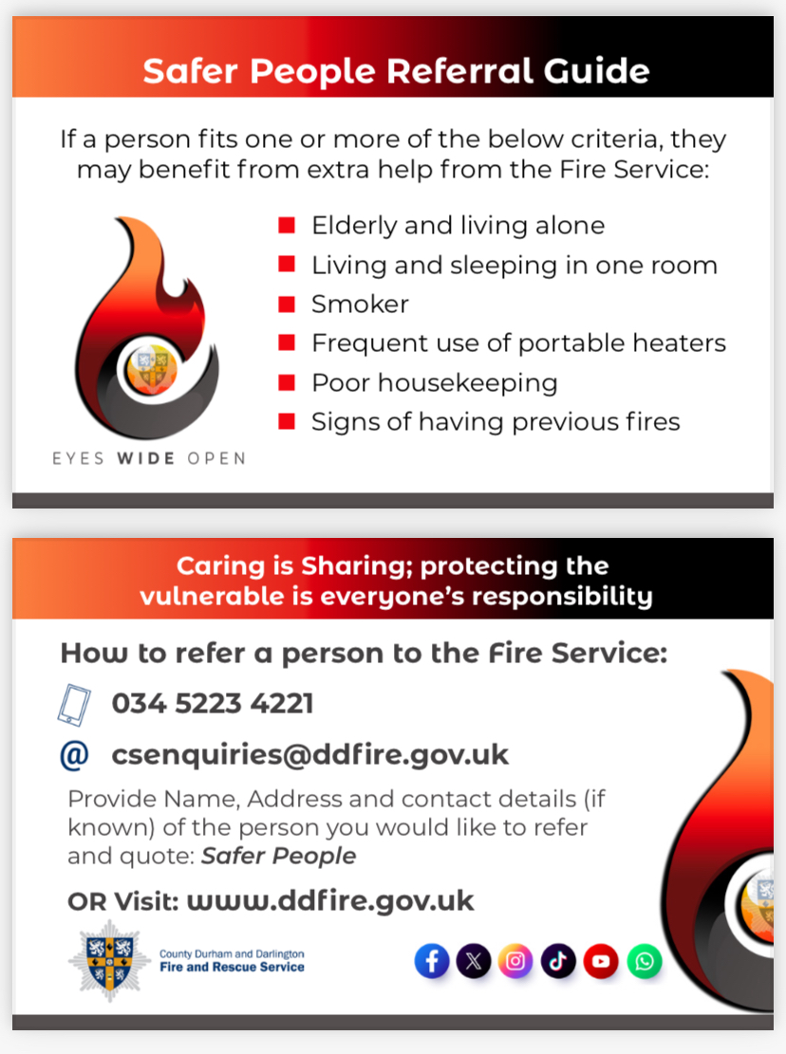
Pocket information card

Slide 10
Any Questions?

Slide 11
Questions? Referral?
Training?
csenquiries@ddfire.gov.uk
0345-2234221
sarah.litt@ddfire.gov.uk
07834-525951

