Slide 1



Intelligence
“Share your information ”
OFFICIAL

Slide 2

What is intelligence?
Intelligence is information we get from a variety of sources such as members of the public, victims, witnesses, suspects as well as police officers/staff to build a picture of criminal activity.
Information comes in many different formats and making sense of these is a critical task for intelligence policing teams. Gathering detailed and thorough information can help to inform decision-making and action taken by police and other partners. Your information, however small, may help to build a picture of what is really going on.
The collection of intelligence / information is crucial to…
Protecting life and property
Preserving Order
Preventing the commission of offences
Bringing offenders to justice
Any duty or responsibility arising from common or statue law
REMEMBER - always call 999 if a crime is currently being committed or if the offender is nearby or if you, a Person, Child or Young Person is at immediate risk of harm or is in danger.
ALTERNATIVELY – If you are reporting a criminal offence, please call 101 and speak directly with a call handler or use our online service or live chat for general enquiries and advice as well as reporting non-urgent incidents or crimes. Please note the 101 Live chat service is not monitored 24/7.

Slide 3
What is the purpose of the form
This form should be used by partner agencies to share information that has been gathered during the course of your work and may be of interest to law enforcement.
The form is to share intelligence NOT to report a crime.
What to consider - information regarding any involvement or witness to any potential criminal offences, conduct or suspicious behaviour, including, but not limited to; exploitation (sexual, criminal, labour etc.), serious and organised crime (including terrorism, drug supply, use of firearms etc.) as well as any information around community tensions and issues.
The information will be recorded on the Police Intelligence Systems and used to support activity by the police and, where appropriate, partner agencies.
The information should be detailed and specific to a particular person, vehicle, or incident i.e. one report per event and information relating to separate events should be on a separate form and submitted in a timely manner.

Slide 4

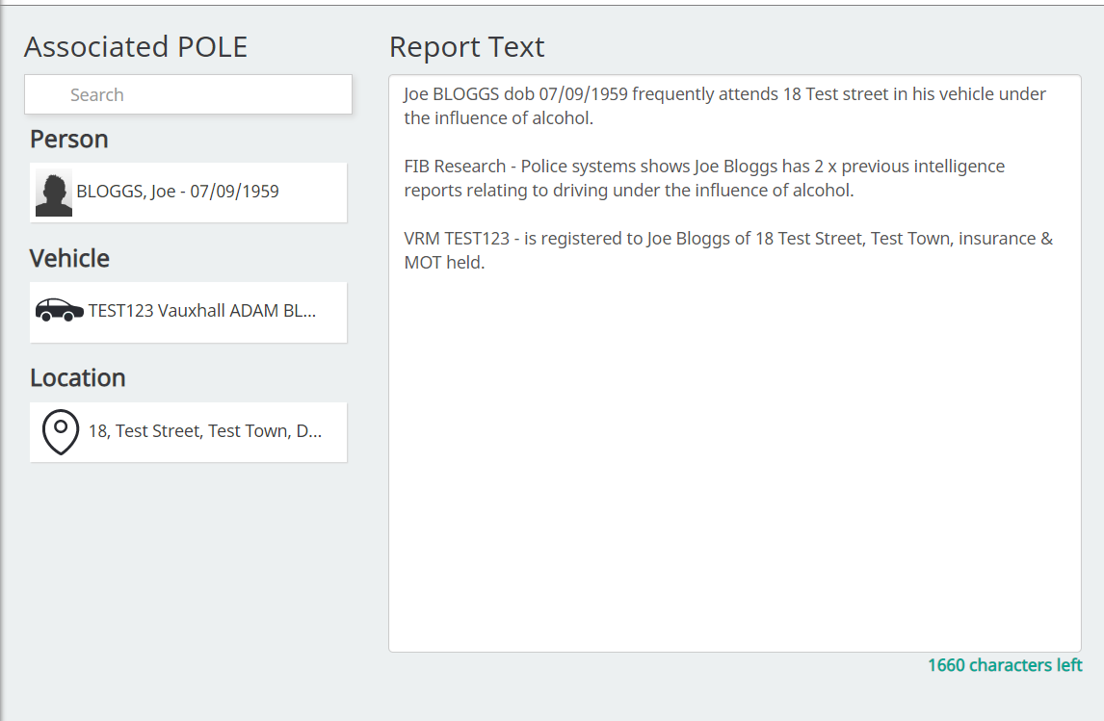
What happens to your information
It is our duty of care to protect any source providing us intelligence
Once the partnership sharing form has been received it will be input onto police systems.
To avoid any chance of compromise we will not place source (information provider) details into the body of the intelligence report.
The final, sanitised version of the report can be seen by all operational officers and staff as shown on the example, any sensitive information will be graded and restricted appropriately.
The below example is what officers will see;
Thank you for your time, if you require any further guidance, please contact D/Insp Hindmarsh or Alexa Lee-Hobson via the Force.Intelligence@durham.police.uk

