Slide 1
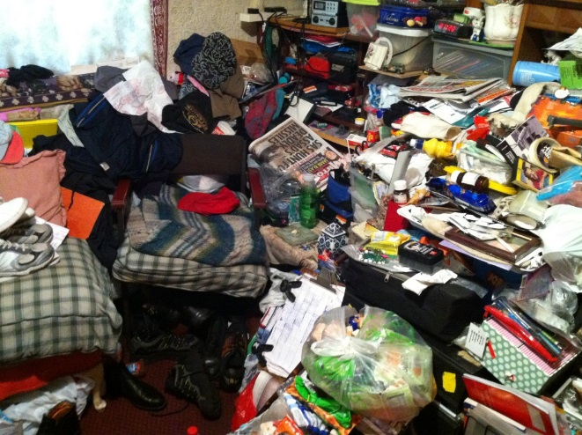
What is Hoarding Disorder?
Professor Nick Neave
Director of the Hoarding Research Group
Chair of the UK Hoarding Partnership

Slide 2

Hoarding Disorder (HD).
Most people accumulate possessions; some are related to survival (e.g. food), but others are kept for sentimental reasons, or are gathered as a coping strategy.
According to the American Psychological Association HD is a recognised clinical condition, and has 4 characteristics:
The acquisition of a large number of items that may be of limited value.
The failure to discard those items.
Severe clutter in living spaces that render the activities associated with those spaces very difficult.
Significant distress or impairment in functioning caused by the hoarding behaviours.

Slide 3
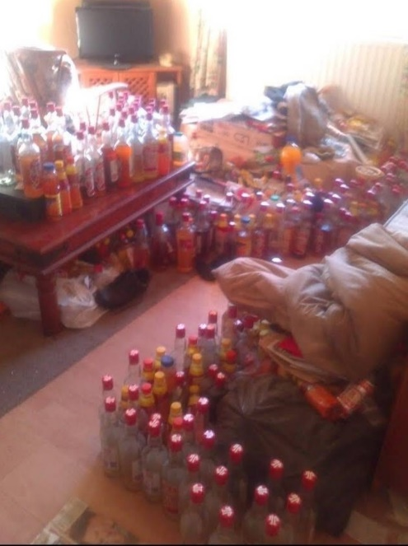
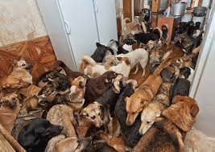

What do people hoard?
Objects and personal possessions.
Newspapers and books.
Clothing and shoes.
Electrical items
Rubbish, food waste (Syllogomania).
Bodily secretions (faeces/urine etc).
Animals.
Digital items (files, photos, music etc)

Slide 4
Demographics
Surveys reveal that people who hoard (PwH) comprise 2-6 % of the population and show the following:
Older.
Single.
Not working full time.
Receiving benefits.
Live in social housing, and in low-income areas.
Have other health and psychiatric problems (e.g. depression/anxiety).

Slide 5
The social/physical costs of hoarding
A higher proportion of work days lost per month equivalent to patients with depression and psychosis.
Increased danger of accidents (trips, falling objects), and disease due to sanitation problems.
Higher risk of eviction or having a child removed from the home.
Health issues and disabilities equivalent to major depression/diabetes.
Increased social isolation and significant reduction in wellbeing and ‘quality of life’.
Families of hoarders report high levels of stress.
Hoarding behaviours are often stigmatised (not helped by sensationalist TV programmes) and hoarding is often ‘hidden’ or ‘marginalised’.

Slide 6
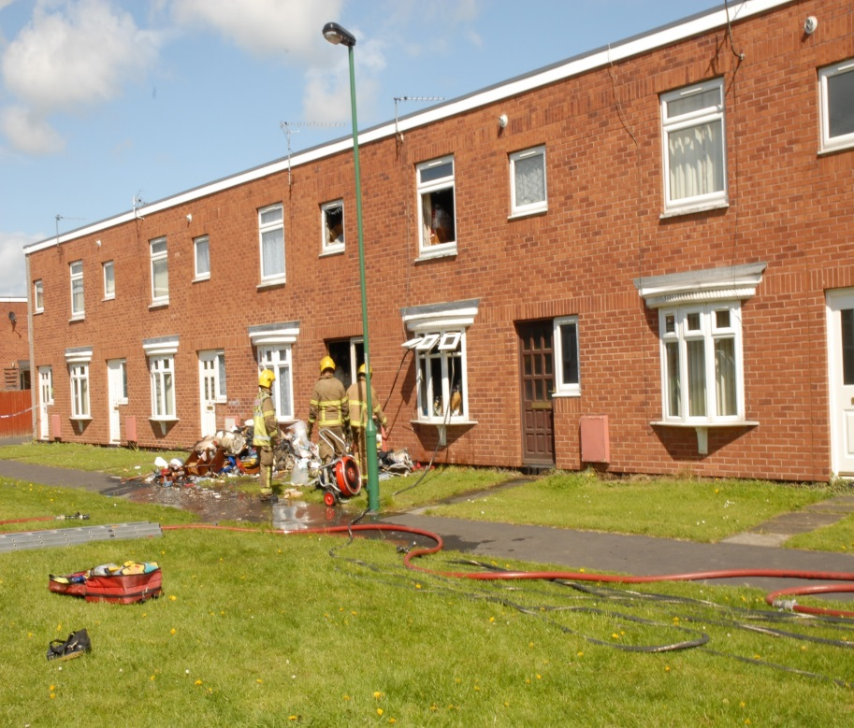
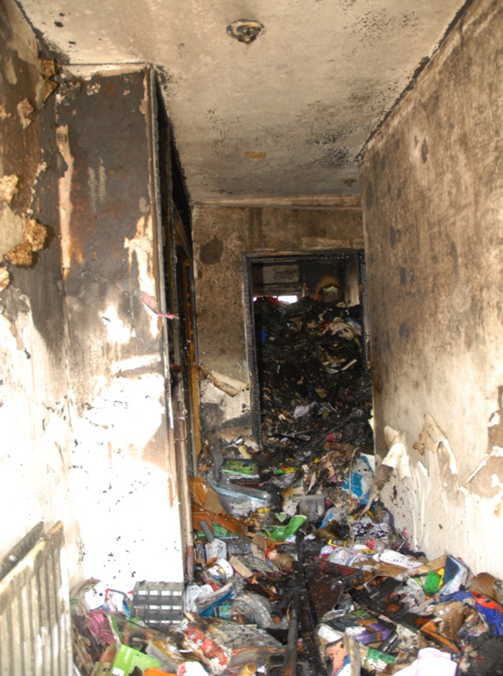
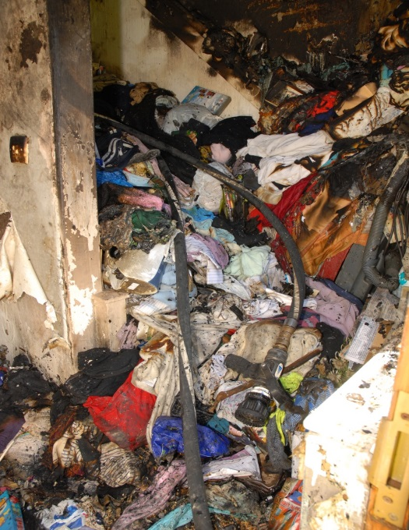
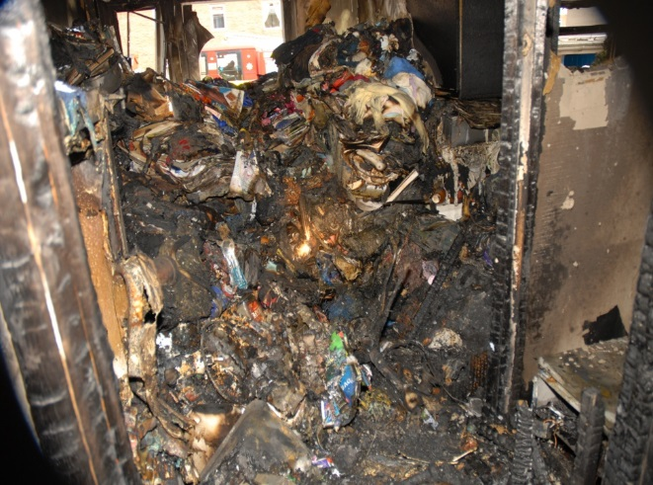
Case of hoarding in County Durham, which resulted in a fatality

Slide 7
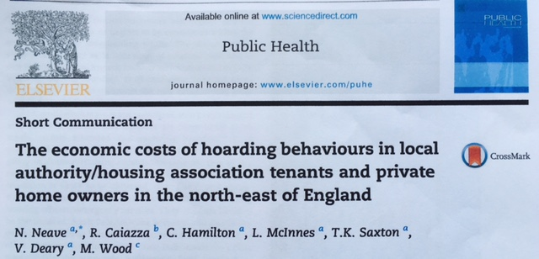
The economic costs of hoarding
We assessed the economic costs of individuals who hoard in the North East.
Surveys were sent to 13 social housing providers and one Emergency Service (Tyne & Wear Fire & Rescue Service), 7 Housing providers responded.
The average number of housing tenants was 15,755, with hoarders comprising 0.14%

Slide 8
Key data
While numbers were small, the majority required significant action in terms of increased staff attention, clean-up operations, and legal action.
Over half of the cases also required the involvement of health and social care services and were highlighted as safeguarding concerns. These costs were not included.
Less than 10% of cases were resolved.
The Housing Providers estimated that each case of hoarding cost them around £15,000 per year, but more complex cases involving evictions/legal fees etc cost up to £35,000.
Hoarding behaviours were estimated to cost the Fire & Rescue Service around £107,000 per annum, and their properties posed a significant danger to fire officers in relation to ease of access.

Slide 9
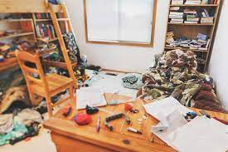

When does hoarding begin?
Hoarding behaviours are not typically identified until the clutter/distress becomes obvious.
PwH are often ashamed of their behaviours and limit access to their property.
Age of onset is childhood and early adolescence with a mean age of onset of around 13.
Clutter and difficulty discarding appear first (in adolescence), followed by acquiring problems, with recognition (insight) that there is a problem developing around 10 years later.

Slide 10
The causes of hoarding?
PwH appear to have experienced higher levels of material deprivation, uncertainty, absent parents/carers, crime, death of a parent, and physical/sexual abuse as children.
The number of Traumatic Life Events (TLE’s) correlates positively with hoarding severity.
The odds of developing hoarding behaviours are much greater in individuals reporting a parent with psychiatric symptoms of depression or mania, or being alcohol dependent.
Hoarding behaviours may thus be a response to uncertainty/trauma/grief, and may be a form of Post-Traumatic Stress Disorder (PTSD).

Slide 11

“Hoarders often live alone, and the hoard can be a defence against intrusion”.
“Loss is a hole, and possessions are the easiest thing to hand if you want to plug it.”
“Nothing can be permitted to leave the house, because every single item, from a dustbin to a plastic toy, is unique and contains intense quantities of memory and meaning.”
“They invest these things with meaning and association, and their lives echo with loss and abandonment”.
“Should you believe that a thing has feelings, or soul, it becomes much harder to discard”.

Slide 12
Comorbidity in hoarding
Certain psychiatric and psychological factors appear to be strongly associated with hoarding behaviours:
Anxiety and depression
Obsessive-Compulsive Disorder (OCD)
Schizophrenia and psychosis.
‘Avoidant’, ‘dependent’ ‘paranoid’ and ‘compulsive’ personalities.
Problems with executive functioning (planning, organization, decision-making, memory etc).
Difficulties in emotion regulation.
ADHD.
ASD.
Intolerance of uncertainty and aberrant salience

Slide 13
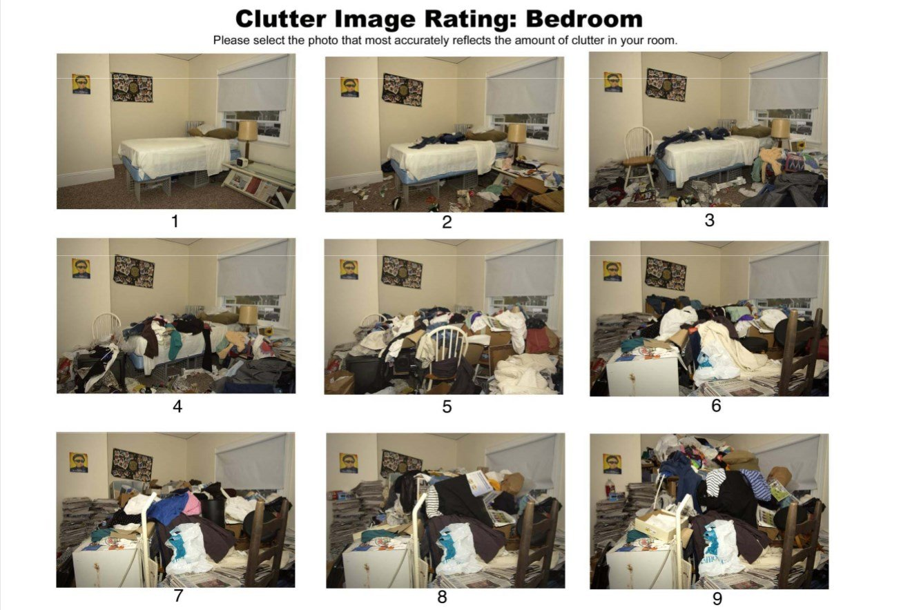
MEASURING HOARDING

Slide 14
Summary of Hoarding.
Hoarding is a genuine psychiatric condition and is not a ‘lifestyle choice’ or due to ‘laziness’.
It may be a type of PTSD caused by childhood trauma, or related to neurodiversity (e.g. autism, ADHD).
PwH need support and treatment – forcibly emptying their property and evicting them does not help them.
A multi-agency approach based around a trauma-centered approach appears to be the best way forward.
There needs to be greater understanding of what hoarding disorder is, how it develops, is maintained, expressed and treated/reduced.

Slide 15
The UKHP
The UK Hoarding Partnership (UKHP) is a forum for professionals and practitioners who deal with hoarding behaviours.
We now have over 140 members from around the UK.
We take a multi-agency and multidisciplinary approach to supporting practitioners, and organisations who work with individuals and their families who struggle to maintain their living environment as a result of hoarding/self-neglect.
We are linked with the Hoarding Research Group at Northumbria University and the UK Hoarding Research Network, organised by Sharon Morein at Anglia Ruskin University, Cambridge.

Slide 16
Priorities for the UKHP
Foster a better understanding of HD in practitioners and the general public to reduce the stigma of this complex mental health condition by developing bespoke training packages and educational materials.
Develop more effective multi-agency ways of working to ensure that PwH are better supported, and that their condition has a limited effect on their lives and the lives of others.
To develop a better understanding of HD by collaborating with research teams sharing professional experiences and developing more ‘research into practice’ activities.

Slide 17
Additional Resources
Hoarding UK https://hoardinguk.org/
Hoarding Disorder UK https://hoardingdisordersuk.org/
Clouds End https://www.cloudsend.org.uk/
Holistic Hoarding https://holistic-hoarding.co.uk/
Actress and hoarder Susanna Amato performs shows about her hoarding experiences and presents a podcast ‘Landfill of Memories’ https://www.susannaamato.com/
There is a podcast called ‘That Hoarder’ that can be accessed via https://www.overcomecompulsivehoarding.co.uk/

