Slide 1





Philomena
Protocol

Slide 2
Definition of a missing person
A missing person is defined as “Anyone whose whereabouts cannot be established, and where the circumstances are out of character or the context suggests the person, may be subject of crime or at risk of harm to themselves or another”

Slide 3

What is the Philomena Protocol
Named after the Patron Saint of infants, children and youth “Philomena”.
REDUCING risk and harm and SAVING life.
A joint response around looked after children who go missing, utilising the golden hour.
Empowers staff should a child go missing as they have the knowledge and information to enable decisions around locating the child.
Improves communication and information sharing between agencies.
To help identify children who are at risk of going missing and allows us to gain as much information on that child so that we can reduce risk.
To ensure that if a child goes missing, they are located quickly reducing risk of harm, and vulnerability.
To further improve how we work together to protect our most vulnerable children.

Slide 4
Why do we need it ?
Some children in care go missing from home repeatedly.
Dealing with Missing Children can be stressful.
Its about preventing the young person going missing.
Knowing the expectations of your role but knowing the actions of everyone else.
A Joined up response that identifies key locations and to assist everyone in the search.
Embed a process and future proof us to be more effective around demand.
SAFEGUARD Vulnerable children

Slide 5
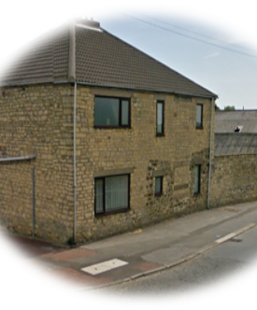
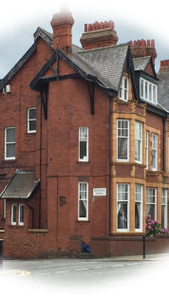
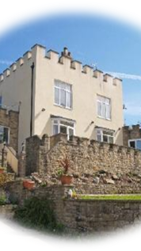
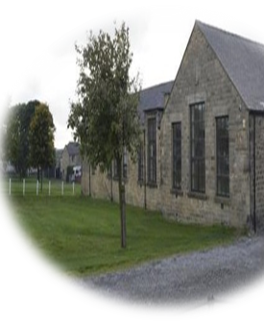
The Current picture – County Durham & Darlington.
57 Children's Homes and also a large number of foster children living in the Durham Constabulary Force area.
Looked after children living in this area are from all over the country.
In 2022 we have the following data
4081 calls to Durham Police of missing children
997 missing from home reports from children's homes alone
254 missing from Foster Care

Slide 6
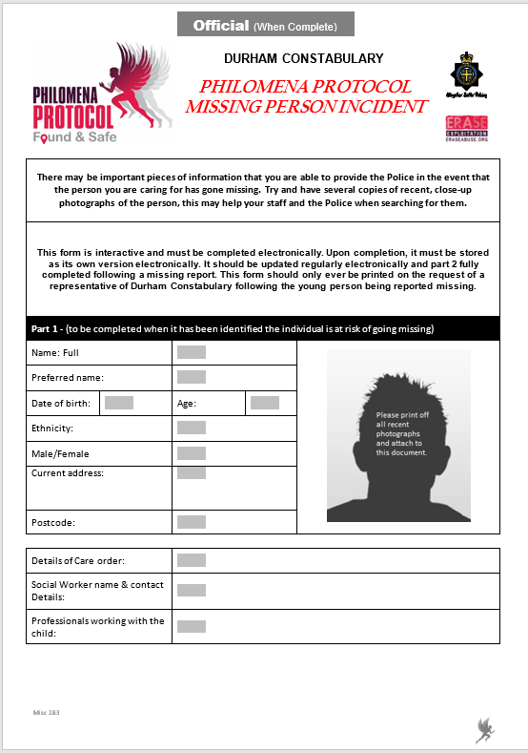

Slide 7
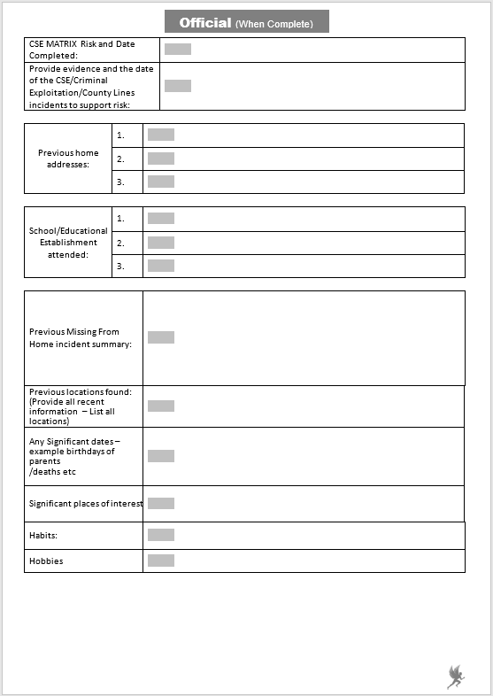

Slide 8
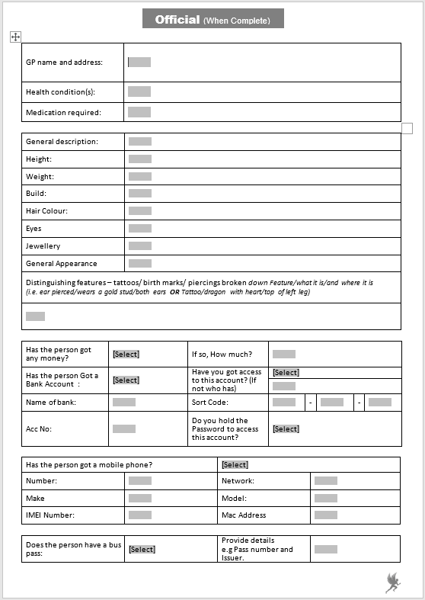

Slide 9
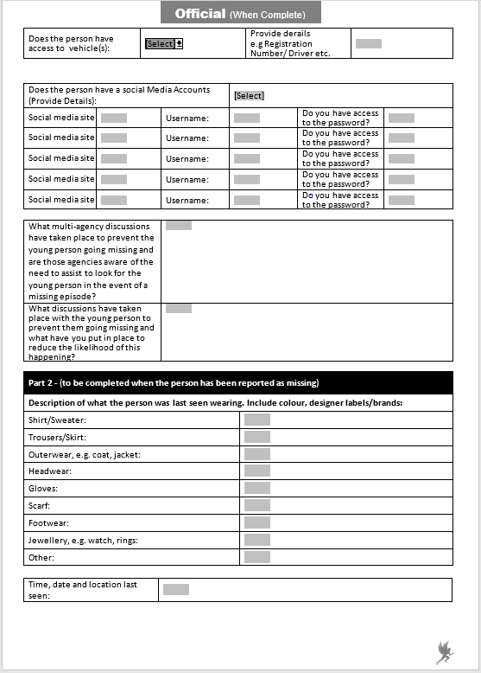

Slide 10
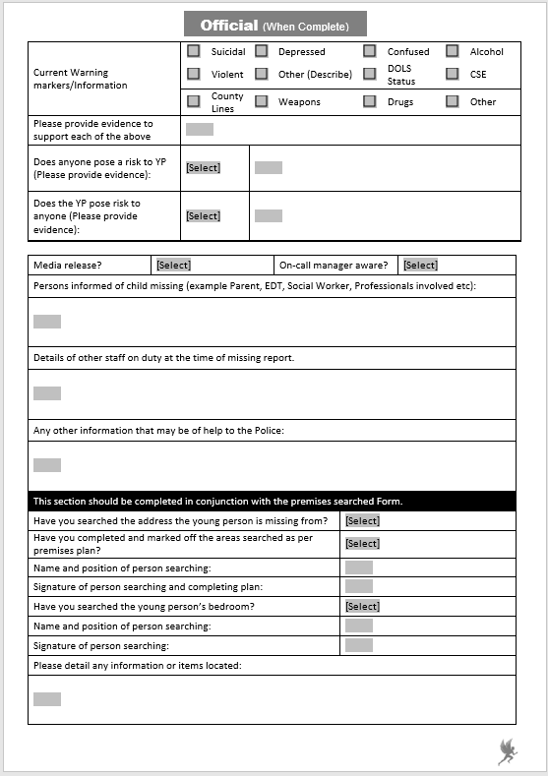

Slide 11
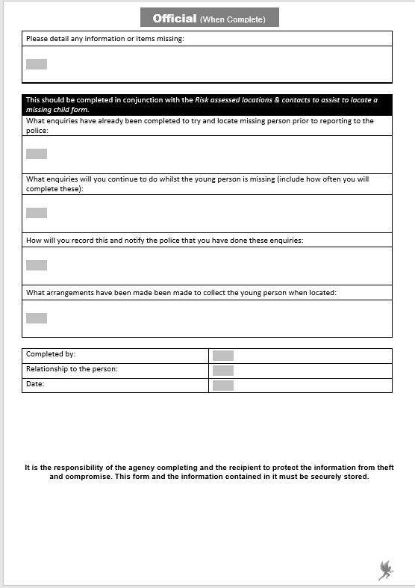

Slide 12
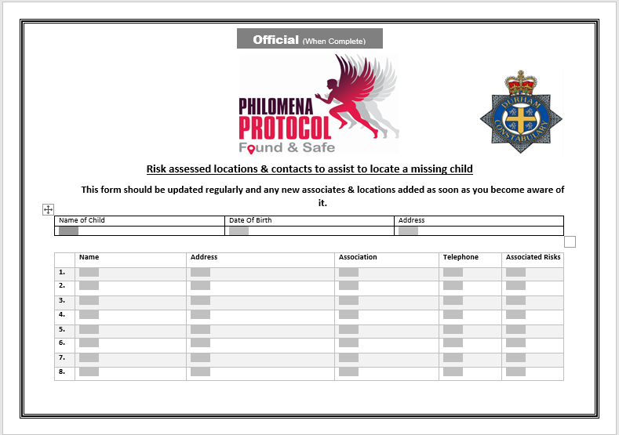

Slide 13
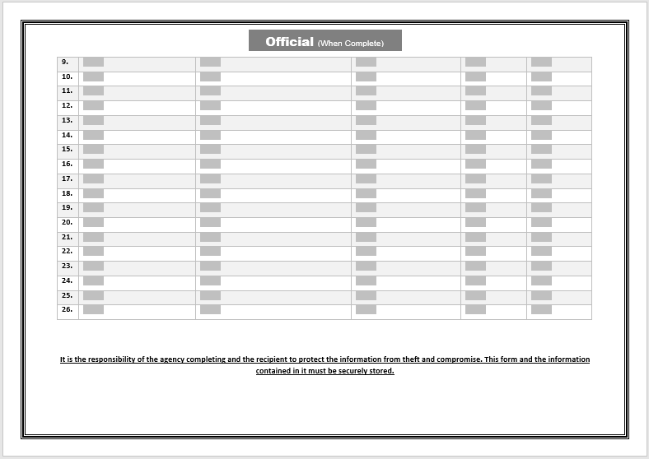

Slide 14
Caller completes Philomena Paperwork and enquiries, ie: calls and searches carried out
Police contact – report of missing child
Police visit address and carry out any further enquiries and search address.
Caller and police to agree joint actions from the Locations/associate's form
Caller to print and hand paperwork to Police (please make sure this happens)
Clear communication and documentation between staff and police will ensure minimum duplication and ensure maximum resources are utilised to the necessary areas in order to locate the missing Child as soon as possible.
If there are any issues around communication, please feed that back to the missing team/ERASE
What is expected?

Slide 15
How will it work?
A Problem solving approach to the Child to prevent a missing episode.
Prevention rather than investigation.
Enquiries by carers made prior to police being called.
Police contacted and paperwork shared for police and carers to start agreed actions.
A joint response that is transparent and avoids duplication. Enquiries completed efficiently & quickly.
Child located and returned with full debrief to update forms and further problem solving around new information obtained.

Slide 16


QUESTIONS
ERASE@durham.police.uk

