Slide 1

Self-Neglect and Hoarding Conference
2nd July 2024

Slide 2
Opening Message
Ann Baxter
Independent Scrutineer/Chair

Slide 3
Darlington Safeguarding Partnership and overview of Safeguarding Adult Review processes
Amanda Hugill
Partnership Business Manager

Slide 4
Safeguarding Partnership Arrangements
Darlington Safeguarding Partnership went live in July 2019 and the arrangements cover both child and adult safeguarding arrangements. Adult arrangements are in accordance with S43 of the Care Act 2014 to establish a Safeguarding Adult Board
What is Darlington Safeguarding Partnership?
Darlington Safeguarding Partnership is the key statutory mechanism for agreeing how relevant organisations in Darlington will cooperate to safeguard adults with needs for care and support in its area.
Statutory Safeguarding Partners (SSP)
Three key leads appointed as Statutory Partners in Darlington are:
Group Director for People – Darlington Borough Council
Detective Chief Superintendent – Durham Constabulary
Director of Nursing – NE&NC Integrated Care Board (Tees Valley)

Slide 5
Statutory Functions
A key function of the Partnership is to undertake Safeguarding Adult Reviews. The statutory requirements are outlined in S44 of the Care Act 2014.
Criteria for Safeguarding Adult Review (SAR)
A review may be commissioned when an adult with care and support needs has died or suffered serious harm and it is known or suspected that the cause was neglect or abuse (includes self-neglect) and there is concern that agencies could have worked better to protect the adult from harm
Safeguarding Adult Review Process
The SSP determine if a case meets the criteria for SAR. If criteria not met the Partnership considers whether there is single or multi-agency learning or practice issues to explore and may initiate a multi-agency learning lessons review, multi-agency audit or single agency review.

Slide 6
Local Picture Safeguarding Adult Review (SAR) referrals and data

Slide 7
Safeguarding Adult Reviews and Learning Lesson Reviews promote effective learning and improvement action to prevent future deaths or serious harm occurring again.
They provide invaluable insight into the way organisations are working together to prevent and reduce abuse and neglect of adults and help to understand the practice issues and areas for improvement in the system.
Reviews also provide an opportunity to explore examples of good practice which can be applied in the future.

Slide 8
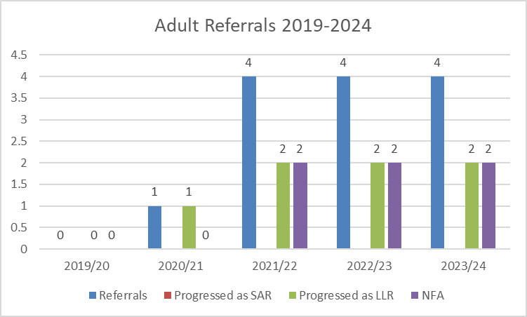
Numbers of Adult referrals since the Partnership went live in July 2019
From the referrals 13 referrals received no statutory SARs undertaken. There were 7 Learning Lesson Reviews (LLR) taken forward (54%), the remainder were reviewed and deemed NFA (46%) as other processes in place (i.e. single agency, no further learning to explore). Of the 7 LLRs undertaken, 5 featured self-neglect (71%)
Nationally Analysis of SAR’s (2019-2023) has identified a marked increase in the number of SAR’s undertaken for self-neglect (from 45% to 60%)

Slide 9
Safeguarding Adult Data 2019-2024 (SAC return)
The data (submitted for the annual Safeguarding Adult Collection return) highlights the number of S42 enquiries concluded where self-neglect identified as category of risk – Darlington data highlights a steady increase year on year.
This is a picture reflected nationally evidenced in the All England data – graph showing upward trend.

Slide 10
What is Self-Neglect?

Slide 11
Definition of Self Neglect
There is no standard definition of self-neglect, but the Care Act 2014 Statutory Guidance provides the following definition:
Self-neglect covers a wide range of behaviour neglecting to care for one’s personal hygiene, health or surroundings and includes behaviour such as hoarding.

Slide 12
Definition of Self Neglect
Social Care Institute for Excellence (SCIE)
What is self-neglect?
Lack of self-care to an extent that it threatens personal health and safety
Neglecting to care for one’s personal hygiene, health or surroundings
Inability to avoid harm as a result of self-neglect
Failure to seek help or access services to meet health and social care needs
Inability or unwillingness to manage one’s personal affairs

Slide 13
Nature of concerns and themes identified through adult reviews (recent and current) where self-neglect was a feature

Slide 14
Good Practice Identified
Evidence agencies had worked together effectively with attempts to reduce the risks
Good Communication with concerns being raised and consistently shared with ASC by other agencies
Services did go above and beyond what they were funded/signed up to do – carers, housing & GP
ASC practice of building relationship with adult first before having those difficult conversations around lifestyle and living conditions
Fire Service engagement with adult to help them understand the benefits of making a change would be a greater benefit to something they didn’t want to happen
Family members involved and kept informed throughout – including attendance at strategy meetings

Slide 15
Key learning points identified through those reviews
Recognition of self-neglect and hoarding is a complex and challenging area and is not always easily identified
The impact of the Pandemic on people and access to services –different outcome?
Lack of collaborative working and coordination between agencies with practitioners often working in ‘silos’ – were there missed opportunities?
Ensuring multi-disciplinary meetings are held at the earliest opportunity
The importance of professional challenge and curiosity for individuals who consistently resist to engage – were there missed opportunities?
Importance of multi-agency decision making in best interests of the adult
Mental health and the adult’s reluctance/non-compliance with services over a period of time
Self-neglect should not be viewed as a lifestyle choice

Slide 16
Key learning points identified through those reviews
The importance of taking into account the history/trauma of the individual
The Importance of building relationships and gaining trust and keeping that dialogue open – exploring practitioner relationships
Cases should not be closed down for those individuals who do not engage or fail to respond to correspondence without having formal discussion with senior managers within the organisation.
Often a presumption of capacity and no evidence of capacity assessments
Understanding hoarding disorder
Consideration of fire safety and smoking risk
Need to consider flexible or creative approaches of working and engage the adult at beginning of assessments
Lack of consistent professional involvement
Good communication and information sharing is key when self-neglect is evident

Slide 17
What has the Partnership done to respond to the learning?

Slide 18
What has the Partnership done to respond to the learning?
Identified Opportunities for learning:
Self-Neglect and Hoarding Conference to raise awareness and focus on some of those practice issues and challenges of working with individuals who self-neglect and are resistant to engage – key speakers today who will focus on the evidence base and research, symptoms and case studies to address some of those practice issues
Provision of training and resources - bespoke training programmes based on learning and themes identified in the reviews - Adult Self Neglect & Mental Capacity Act Awareness e-learning, Information Sharing podcast, Professional Challenge Youtube video, Briefings on findings from DSP reviews
Contributed to a series of 7 minute briefings published regionally on key issues around aspects of self-neglect

Slide 19
What has the Partnership done to respond to the learning?
Established a multi-agency Self-Neglect Task and Finish Group to lead on the development of guidance, resources and tools to support practitioners:
A revision of the Multi-Agency Practice Guidance in respect of self-neglect and hoarding to include:
  key characteristics of self-neglect and hoarding
  mental capacity guidance to help improve confidence in apply MCA into practice
  Examples of positive, flexible and creative approaches to support practitioners when refusal/resistance to support/service offer
  clutter scale tool
  issue of consent and choice
  Making Safeguarding Personal
Establishment of Risk Enablement Forum to manage those complex cases
Provision of multi-agency Risk Assessment Tool and self-neglect pathway to aid practitioners

Slide 20
What has the Partnership done to respond to the learning?
Implemented Multi-Agency Quality Assurance processes for live cases
The Partnership’s Quality Assurance & Performance Management Group (QAPM) has responsibility for scrutinising and evaluating the effectiveness of safeguarding arrangements through multi-agency performance data and quality assurance activity.
The QAPM will collectively discuss a number of live cases on a quarterly basis which correlate with the learning from reviews to validate and check whether practice has changed and that the change is embedded.

Slide 21
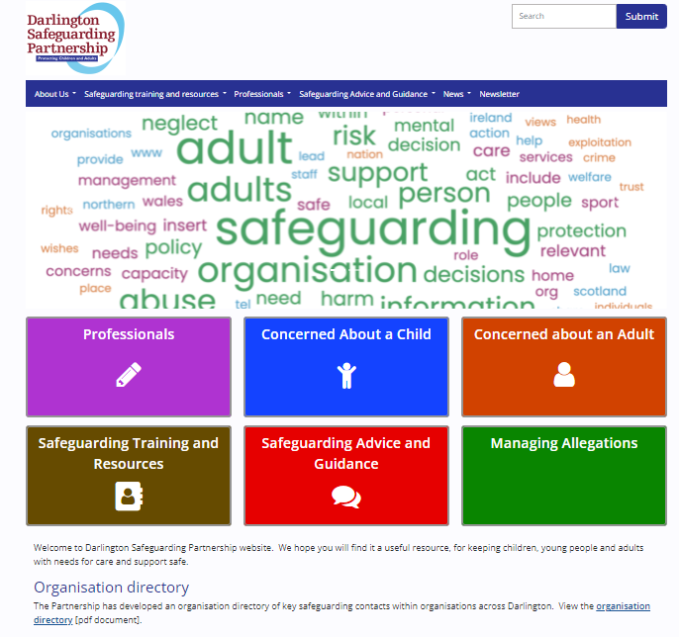
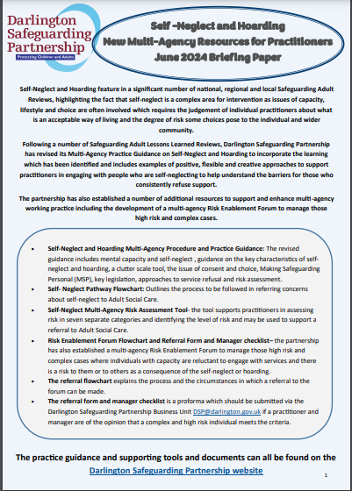
DSP offers a wide range of multi-agency policy, procedure, guidance and resources relating to self-neglect which are available on the DSP website – including those resources being shared today:
www.darlington-safeguarding-partnership.co.uk

Slide 22
North East region of the Association of Directors of Adult Social Services (ADASS) developed a ‘What to do about self-neglect’ animation to raise public awareness of self-neglect:
Youtube Video

