Slide 1



Heading
Right Care, Right Person
Police questions

Slide 2
Things to consider prior to contacting the Police
Police will attend when there is an immediate risk to life or serious harm to an individual or wider public.
Police will need to know
What are the specific concerns? | Be as detailed as possible. Include any physical injuries, MH background. Why you believe there is an immediate risk.
What actions have you taken? | Detail ALL actions taken including address checks, phone calls to the individual/family/friends etc.
Does the concern relate to a child? | Even if the call is not about a child are there children that will be significantly impacted? Provide full details.
Is the person detained under a legal framework? | DOLS/Mental Health/Capacity Act - explain the context
Why are Police required? | What are the legal powers for Police – Mental Health/Capacity Act, power of entry. Police do not always have a power and the threshold for response is high.
What is your relationship with the individual? | It's important that Police understand your knowledge and experience with the individual to accurately risk assess.

Slide 3
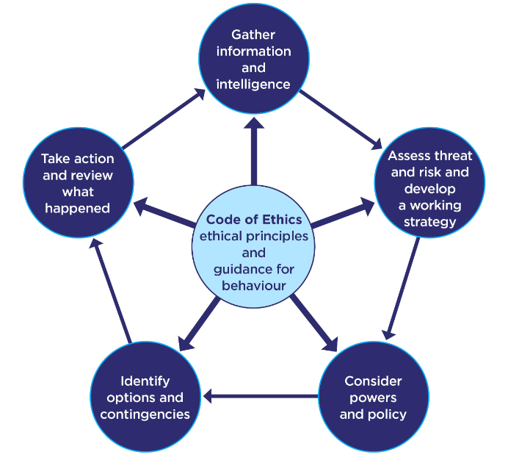
Risk Assessment tool used by Police
T - Threat
H - Harm
R - Risk
I - Investigation
V - Vulnerability
E - Engagement

Slide 4

Initial Information
Which agency are you calling from?
Does the concern relate to a child?
What is your relationship to the individual?
Does the concern relate to physical or mental health?

Slide 5
Further questions to consider
Is the individual's location known?
Have reasonable enquires been made to establish their whereabouts?
Are the Police required to support due to immediate and significant risk to the public or partner agency?
Is there a real and immediate risk to life/serious harm to an individual or the wider public?
Why are Police required/Are Police the most appropriate agency?

Slide 6
Police response decision
Yes
Maybe
No
“This incident does not meet the threshold for attendance and as a result the police will not be attending or taking any action in relation to this incident at this time. Responsibility for this incident remains with your agency. You must keep the risk assessment under review and recontact police if the situation changes or escalates.”
“This incident meets the threshold for attendance and as a result the police will assist you in this matter.”
“At this time, the incident does not clearly meet the threshold for attendance and as a result a further risk review will be instigated, including further checks. While these checks are being made, the police will not be attending this incident and at this time you will remain responsible. The police will make further contact with you in due course (obtain a contact number). In the meantime, your own agencies policies, procedures and escalation processes apply.”

