Slide 1


Review of the Family H case
Amanda Hugill – Business Manager
February 2024

Slide 2
The Scope of the Review
The Review
Introduction
The Process of the Review

Slide 3
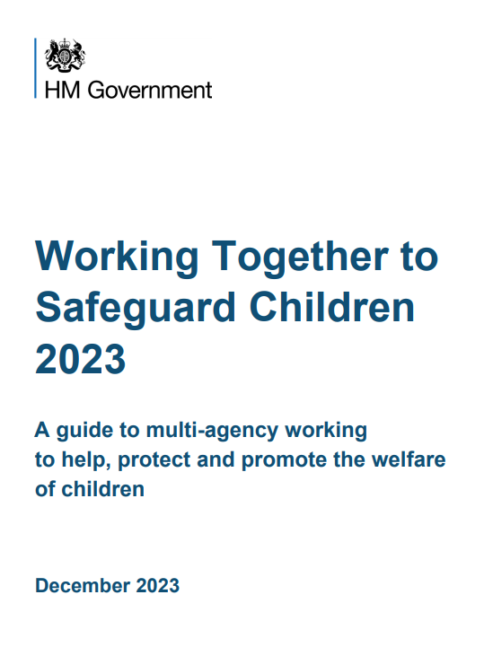
The Review
Darlington Safeguarding Partnership undertook a Local Child Safeguarding Practice Review (LCSPR) in 2023 regarding Family H.
Working Together to Safeguard Children 2018 (now 2023) statutory guidance sets out the process for Local Child Safeguarding Practice Reviews.
In line with that Statutory Guidance, Darlington Safeguarding Partnership conducted a Rapid Review, and it was decided that a LCSPR was appropriate, and the Child Safeguarding Practice Review Panel (National Panel) was notified.

Slide 4
The Process of the Review
The Partnership appointed two Independent Authors to lead the review, Rachel Upton and Alison Johnson, Designated Nurses for Safeguarding Children, North East and North Cumbria Integrated Care Board.
The purpose of the review was to look at how multi-agency services worked together to safeguard the Family H children.
The review was undertaken using a hybrid systems approach and significant incident learning process (SILP) methodology. This process engages front line staff and their managers in reviewing cases and focuses on why those involved acted as they did at the time, avoiding hindsight bias and individual blame.

Slide 5
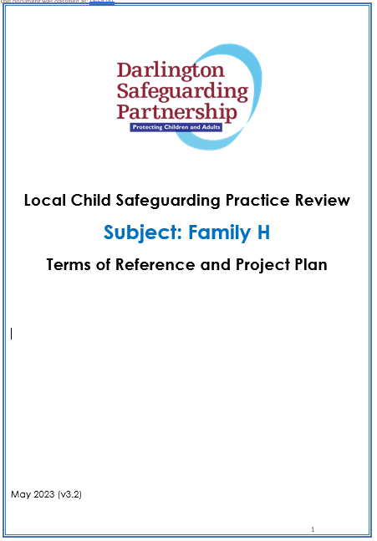
Scope of the Review
The review considered agency involvement from January 2012 to January 2023.
Family H were not open to statutory safeguarding services at the time of notification. However it became evident over the period of the review there had been multi-agency involvement and a number of referrals to Children’s Social Care.
Key agencies were invited to be involved in the review and agreement that adult records should also be included within the scope of the review.

Slide 6
Background and Focus of Review

Slide 7

Background
Family H consists of 4 children under the age of 16. The family is white British, father originates from local area and mother originated from outside of local area with minimal support from her own family. Parents often struggled to cope with four children and paternal grandmother provided a high level of support to the family. Children were presented as happy and content and well dressed and interacted well. The two eldest children had some health issues and assessments which identified speech and language and developmental delays. The younger siblings were generally healthy.

Slide 8
Incident that led to Notification
In April 2022, the children’s aunt and her partner were arrested due to suspected sexual offences against children and their devices were seized. Examination of the devices found indecent images of children and further enquiries led the police to believe that the Family H children were also victims of sexual abuse.
Aunt’s partner had been convicted in 2004 of sexual assaults on a child under 13, at the time of that offence he was 12 years of age. He was classed as a Schedule 1 offender.
Children’s Aunt had two children removed from her care (first child 2012), there is limited information but appears to be due to her inability to provide safe care along with the risks posed by her partner.
.

Slide 9

Focus of Review
The review focussed on a number of key episodes over a ten-year period which were deemed central to understanding the work undertaken with Family H. The episodes do not form a complete history but were key from a practice perspective.
This started, in 2013, with parents agreeing to abide by a written agreement which stated aunt and her partner should have no unsupervised contact with their children due to aunt having her own children removed and being in a relationship with a partner who has previous sexual offences against children and potentially remained a risk.

Slide 10
Child’s lived experience
Mother was care experienced and had a history of low mood and often admitted to struggling with one of the children’s behaviours who demanded a lot of her attention. Parents relationship was at times described as strained due to having four young children.
School reported the children as being well presented, happy and content and participated well in all aspects of school life, attendance was consistently good. They were always well dressed in the correct uniform. Homework, including reading at home, was in line with expectations.
All three children had wide friendship groups and consistently interacted positively with peers and staff.

Slide 11
Key Findings and Learning

Slide 12
A number of areas of good Practice were identified:
Police notified Children’s Services when Aunt told them she was pregnant and trying to conceal from agencies
TAF in place for sibling 2 due to SEN, meetings held regularly – parents engaged well
Nursery contact with Police and Children’s Services following a trip to seaside when alerted to Aunt and Partner seen speaking to family
Health Visitor advised nursery to make a social care referral when she was informed by nursery staff that Siblings 1 and 2 were often upset around males and shared information with Children’s Services of parents living opposite and working with Aunt’s partner
Adult 1’s GP identified there were no safeguarding concerns documented within computerised records despite knowledge of the risks he posed, this was escalated and resulted in a liaison with the couple's social worker
Nursery Nurse and Physiotherapist were tenacious in recording details of unknown adults within the home
Good communication from Safe Families Service a voluntary group offering support to children and families
The referral to Children’s Services in 2023, following Aunt and Partner being arrested at train station progressed within 90 minutes and children being protected immediately and placed in foster care that day

Slide 13
Key Learning
Professional Curiosity and Challenge
There were some good examples of professional curiosity, several instances where this could have been improved
Some agencies were considering the link between the children’s behaviour and the possibility of sexual harm
The lack of professional curiosity and challenge led to missed opportunities to identify the risk – the risks are not always obvious
Practitioners need to understand what is happing in a family, rather than making assumptions
Assessment of Risk
The risks posed by the adults were never fully explored and understood by agencies involved with the family
Information Sharing and Early Help
There is always an element of poor information sharing in many LCSPR’s
Risk assessments was not applied to any of the work undertaken in the early intervention framework
Some agencies held information regarding the risks, however these risks were not always shared and therefore the significance of the risks was lost over time.
Key pieces of information about the risks posed were not always shared and the focus was always on the health needs of the children rather than the risk of sexual abuse.
Information about the written agreement was not shared
No record of sharing information regarding previous reported concerns and cases closed without liaison with others
GP did not have alert on system regards Adult 1, should he have presented, not aware of risk posed

Slide 14
Key Learning
Professional Curiosity and Challenge
There were some good examples of professional curiosity, several instances where this could have been improved
Some agencies were considering the link between the children’s behaviour and the possibility of sexual harm
The lack of professional curiosity and challenge led to missed opportunities to identify the risk – the risks are not always obvious
Practitioners need to understand what is happing in a family, rather than making assumptions
Assessment of Risk
The risks posed by the adults were never fully explored and understood by agencies involved with the family
Risk assessments were not applied to any of the work undertaken in the early intervention framework
Some agencies held information regarding the risks, however these risks were not always shared and therefore the significance of the risks was lost over time
Information Sharing and Early Help
There is always an element of poor information sharing in many LCSPR’s
Key pieces of information about the risks posed were not always shared and the focus was always on the health needs of the children rather than the risk of sexual abuse.
Information about the written agreement was not shared
No record of sharing information regarding previous reported concerns and cases closed without liaison with others
GP did not have alert on system regards Adult 1, should he have presented, not aware of risk posed

Slide 15
Key Learning
Professional Curiosity
There were some good examples of professional curiosity, several instances where this could have been improved
Some agencies were considering the link between the children’s behaviour and the possibility of sexual harm
The lack of professional curiosity and challenge led to missed opportunities to identify the risk – the risks are not always obvious
Practitioners need to understand what is happing in a family, rather than making assumptions
Assessment of Risk
The risks posed by the adults were never fully explored and understood by agencies involved with the family
Risk assessments was not applied to any of the work undertaken in the early intervention framework
Some agencies held information regarding the risks, however these risks were not always shared and therefore the significance of the risks was lost over time
.
Information Sharing and Early Help
There is always an element of poor information sharing in many LCSPR’s
Key pieces of information about the risks posed were not always shared and the focus was always on the health needs of the children rather than the risk of sexual abuse
Information about the written agreement was not shared
No record of sharing information regarding previous reported concerns and cases closed without liaison with others
GP did not have alert on system regards Adult 1, should he have presented, not aware of risk posed
Notes:
Darlington Borough Council setting up Early Help Strategic Board – bring together partners to help transform the Early help agenda

Slide 16
Key Learning
Unseen Adults
It was evident this was a busy household and adults unknown to practitioners were often present during visits
This was noted by practitioners, but not tenaciously pursued and not through the lens of additional household members posing a risk or indeed understanding how they were involved with the children’s daily lives
Practitioners need to be more inquisitive and ask questions about unknown visitors
Agency assessments should be extended to include all adults involved with the children
Recognising Harm for Children with Disabilities
Maltreatment of children who are disabled or have chronic illness can be ‘hidden in plain sight’ with the disability being seen first and the possibility of abuse not considered
Children with learning disabilities are at greater risk of abuse and may only display their distress through behaviour
Practitioners should not assume that challenging behaviour in a child with a learning disability is due to their underlying condition or parenting and should take a holistic approach that considers possible alternative causes
Children’s Lived Experience
One of the core principles of effective safeguarding practice is a child centred approach which is focused on understanding the lived experience of children – children who have developmental or communication needs can effectively be hidden from view
There is little evidence of agencies considering speaking to or carrying out a piece of work with the children to consider the wider involvement of family members in a holistic assessment to afford early identification of risk
Assessments did not place the children’s lived experiences in the context of their parent’s own backgrounds and their immediate and wider family and how this might impact on their ability to protect

Slide 17
Key Learning
Unseen Adults
It was evident this was a busy household and adults unknown to practitioners were often present during visits
This was noted by practitioners, but not tenaciously pursued and not through the lens of additional household members posing a risk or indeed understanding how they were involved with the children’s daily lives
Practitioners need to be more inquisitive
Agency assessments should be extended to include all adults involved with the children
Recognising Harm for Children with Disabilities
Children’s Lived Experience
One of the core principles of effective safeguarding practice is a child centred approach which is focused on understanding the lived experience of children – children who have developmental or communication needs can effectively be hidden from view
There is little evidence of agencies considering speaking to or carrying out a piece of work with the children to consider the wider involvement of family members in a holistic assessment to afford early identification of risk
Assessments did not place the children’s lived experiences in the context of their parent’s own backgrounds and their immediate and wider family and how this might impact on their ability to protect
Maltreatment of children who are disabled or have chronic illness can be ‘hidden in plain sight’ with the disability being seen first and the possibility of abuse not considered
Children with learning disabilities are at greater risk of abuse and may only display their distress through behaviour
Practitioners should not assume that challenging behaviour in a child with a learning disability is due to their underlying condition or parenting and should take a holistic approach that considers possible alternative causes

Slide 18
Key Learning
Unseen Adults
It was evident this was a busy household and adults unknown to practitioners were often present during visits
This was noted by practitioners, but not tenaciously pursued and not through the lens of additional household members posing a risk or indeed understanding how they were involved with the children’s daily lives
Practitioners need to be more inquisitive
Agency assessments should be extended to include all adults involved with the children
Recognising Harm for Children with Disabilities
Maltreatment of children who are disabled or have chronic illness can be ‘hidden in plain sight’ with the disability being seen first and the possibility of abuse not considered
Children with learning disabilities are at greater risk of abuse and may only display their distress through behaviour
Practitioners should not assume that challenging behaviour in a child with a learning disability is due to their underlying condition or parenting and should take a holistic approach that considers possible alternative causes
)
Children’s Lived Experiences
One of the core principles of effective safeguarding practice is a child centred approach which is focused on understanding the lived experience of children – children who have developmental or communication needs can effectively be hidden from view
There is little evidence of agencies considering speaking to or carrying out a piece of work with the children to consider the wider involvement of family members in a holistic assessment which may have afforded early identification of risk
Assessments did not place the children’s lived experiences in the context of their parent’s own backgrounds and their immediate and wider family and how this might impact on their ability to protect

Slide 19
Key Learning
Identification and Assessment of the Risk of Sexual Harm
The Role of the Non-Abusing Parent
It has been highlighted in reviews that not enough attention is paid, or assessments completed regarding the needs and circumstances of a non-abusing parent or an evaluation of how to understand their willingness and capacity to keep children safe
Professionals need to consider the role of a non-abusing parent or extended family
It is critical that there is an assessment of the non-abusing parent’s ability to protect and believe children
This review highlights the challenges professionals have, the complexities of working with child sexual abuse, and the importance of clarity regarding risk and need
It was evident that the majority of professionals involved were not fully aware of the risks posed
Identifying sexual abuse is difficult as there is often no physical or medical evidence and children are unlikely to tell someone they are being abused, especially if it is someone they know
Because of the difficulties children face in disclosing abuse to adults, their behaviour may be the only indication that something is amiss
Practitioners rely too much on a child making a disclosure, front-line practitioners should be able to recognise the signs of sexual abuse and feel comfortable discussing it with all involved
Agencies should have strong information sharing protocols, with appropriate training and supervision

Slide 20
Key Learning
Identification and Assessment
This review highlights the challenges professionals have, the complexities of working with child sexual abuse, and the importance of clarity regarding risk and need
It was evident that the majority of professionals involved were not fully aware of the risks posed
Identifying sexual abuse is difficult as there is often no physical or medical evidence and children are unlikely to tell someone they are being abused, especially if it is someone they know
Because of the difficulties children face in disclosing abuse to adults, their behaviour may be the only indication that something is amiss
Practitioners rely too much on a child making a disclosure, front-line practitioners should be able to recognise the signs of sexual abuse and feel comfortable discussing it with all involved
Agencies should have strong information sharing protocols, with appropriate training and supervision
The Role of the Non-Abusing Parent
It has been highlighted in reviews that not enough attention is paid, or assessments completed regarding the needs and circumstances of a non-abusing parent or an evaluation of how to understand their willingness and capacity to keep children safe
Professionals need to consider the role of a non-abusing parent or extended family
It is critical that there is an assessment of the non-abusing parent’s ability to protect and believe children

Slide 21
Specific areas identified by the National Panel for Durham Constabulary to explore:
Recognising and assessing the risk of an offender, including the management and risk assessment of a young offender
When adult 1 was sentenced for crimes against children in 2004, MAPPA (sex offender registration) were ordered but then withdrawn because he did not fit the legal MAPPA criteria at that time due to his age. Due to his offences, he was listed as a schedule 1 offender which had been recognised and shared at various points.
Risk management is at the forefront of everything Durham Constabulary does with all safeguarding forms being triaged which identify children at risk of sexual abuse and ensures the risk assessment is correctly graded using standard, medium, and high. MAPPA arrangements are in place to manage the risks and special considerations may apply to the management of young offenders.

Slide 22
Specific areas identified by the National Panel for Durham Constabulary to explore:
Understanding familial relationships and access to children
Durham Constabulary recognised that consideration needs to be given in cases where the abuser is family or feels like family from the child’s point of view and is not. Perpetrators may or may not be related to the child. Recognising that familial harm is the damage caused by adverse circumstances, vulnerabilities, and/or negative behaviours that often lead to long-term negative consequences.
As a result of a change in process, the digital forensic unit now looks at intrafamilial/familial harm when they triage devices. There is also a reliance on investigating officers to accurately record the family links on systems and any form submitted.
Fast tracking digital devices for forensic examination (Police)
In line with Durham Constabulary’s service level agreement, the digital devices took 8 months to be reviewed, that agreement indicates 9 months for standard risk cases and 14 days for high risk cases. The information reported at the time indicated it was a standard risk and therefore no priority was given. A sergeant within the digital forensic unit will now review the submissions on LIMA, risk assess, and prioritise work accordingly, changes to the submission form have allowed for a greater understanding of risk.

Slide 23
Conclusion and Recommendations

Slide 24

Conclusion
There are important lessons to learn from this review, these circumstances are a reminder of the need to equip all professionals with the knowledge, skills and frameworks to identify and respond to sexual harm and the need to identify hidden adults within the family home.
A number of recommendations were identified to reflect the areas deemed as priority areas for improvement.

Slide 25
A) Darlington Safeguarding Partnership to review the effectiveness of weekly review meetings from a multi-agency lens through an audit.
B) DSP to review the MASH triage processes and membership to ensure all staff who are required to cover are fully trained in the process.
DSP to promote reflective discussion standards being implemented by single agencies and work towards multi-agency reflective discussions.
DSP to launch a challenge pledge (to be read out at start of multi-agency meetings).
Recommendations

Slide 26
DSP to promote the awareness and use of a multi-agency harm matrix tool across all partner agencies.
DSP to seek assurance that there is good communication and sharing of information for multi-agency meetings/forums.
All agencies to be aware of the need to identify and document additional adults within the home and unseen persons to inform their risk assessments and share within multi-agency forums. Promote the use of genograms. Develop a training tool/video.
Recommendations

Slide 27
DSP to undertake a mapping exercise to understand the tools/processes agencies have in place to capture the lived experience of the child which may influence decision making.
DSP to provide multi-agency training on identifying sexual harm and including children with disabilities along with the findings and learning from this review.
All agencies to implement their own learning as identified in agency reports and the DSP to seek assurance from all agencies that the learning and recommendations from this review is embedded in practice and an ongoing monitoring process is in place to demonstrate impact.
Recommendations

Slide 29
Child Safeguarding Practice Panel response (National Panel)

Slide 30
The National Panel reviewed the overview report and provided positive feedback:
‘We discussed your LCSPR on 21 November 2023 and thought it was a good review that had identified relevant learning and its impact, which was helpfully presented as ‘missed opportunities’. We thought the Significant Incident Learning Process methodology provided a good framework for your review’.
The review raises a number of issues relevant to our forthcoming national review of
child sexual abuse in the family environment and we will probably therefore include it
in our sample of cases considered as part of the national review.

Slide 31
National Review into child sexual abuse within the family environment
In November 2023 the Child Safeguarding Practice Review Panel (National Panel) announced that it would conduct a national review into child sexual abuse within the family environment with the aim of exploring the specific challenges in the identification, assessment, and response to child sexual abuse within the family environment. The review will address how multi agency and local and national safeguarding practice can improve and respond better to and protect children from this type of harm.
The panel has indicated that the report is expected to be published later in 2024.

Slide 32
Next Steps

Slide 33
To ensure that the relevant actions identified to respond to the recommendations are implemented, and that learning is embedded and incorporated into single and multi-agency training.
All agencies to implement their own learning and to provide assurance to the DSP of ongoing monitoring of the learning points from this review and demonstrate the impact it has had on practice.
To develop resources including a series of briefing documents on the themes highlighted in the review to support practitioners.
Next Steps:
.

Slide 34
Assuring ourselves of Change
Statutory Safeguarding Partners and key safeguarding leads to agree an approach which will re-assure the Partnership that learning from reviews and quality assurance activity is embedded.
The QAPM will collectively discuss a number of cases on a quarterly basis which correlate with the learning from reviews on a regular basis to validate and check whether practice has changed and that the change is embedded.
For example, with regards to the Family H review, the group will look at family's who have closed to social care with a safety plan in place and reflect on the multi-agency practice and decision making and how it is aligned to the improvements identified in the review.

Slide 35
Final Report
Family H Final Report
Executive Summary
Family H Executive Summary
If there is anything you wish to discuss further, please contact Amanda Hugill, Partnership Business Manager
Amanda.Hugill@darlington.gov.uk

